Slide 1



Home
Service
About Us
Contact
Centralized Club Management System
Explore Now
01

Slide 2


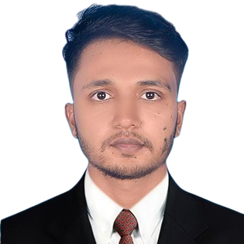




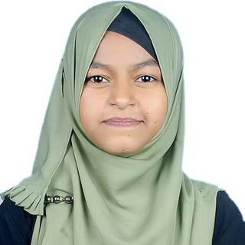
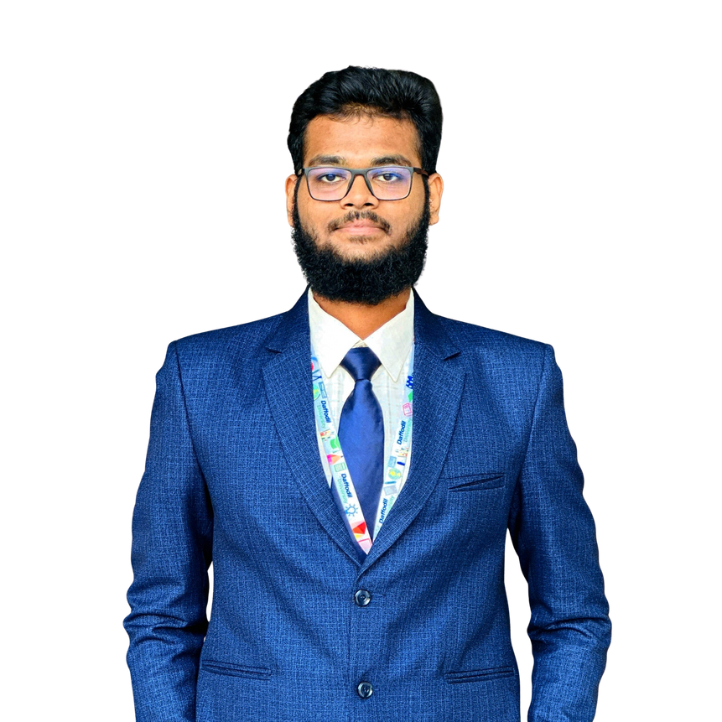
Reduan Ahmad
ID : 232-35-016
Section : A
Monira Islam
Our Team
ID : 232-35-017
Section : A
Abdullah Al Noman
ID : 232-35-003
02
Section : A

Slide 3

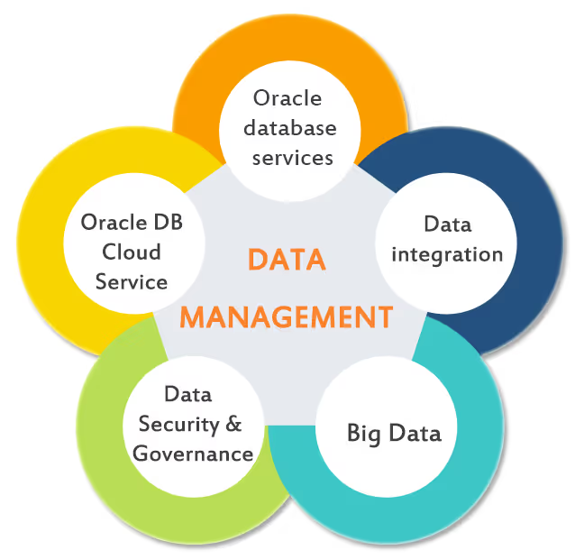
About Project
At our university, student clubs organize events, activities, and memberships, but without a centralized database, managing them is difficult. Organizers struggle to keep track of members, event participation, and communication. To solve this, we propose a Centralized Club Management System .
03

Slide 4

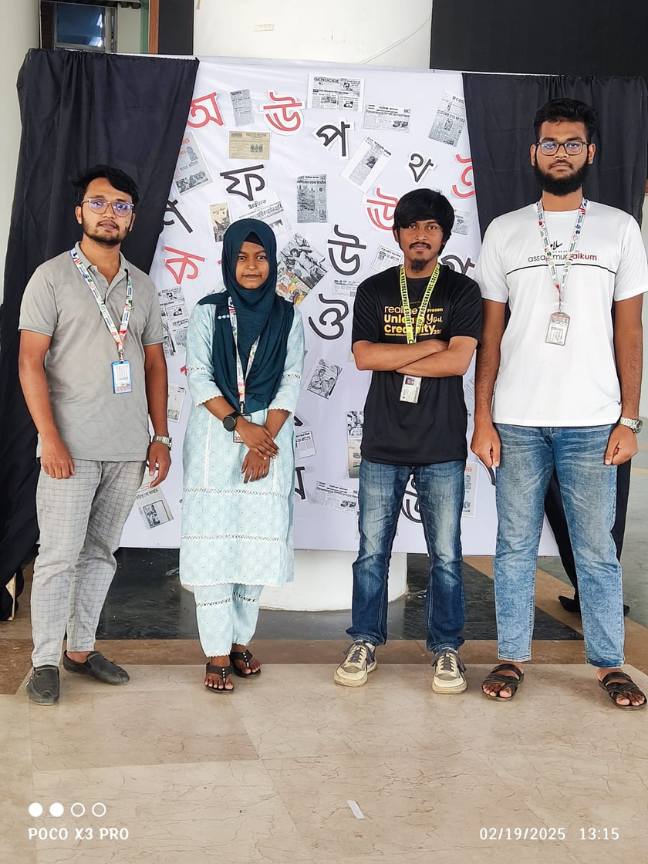
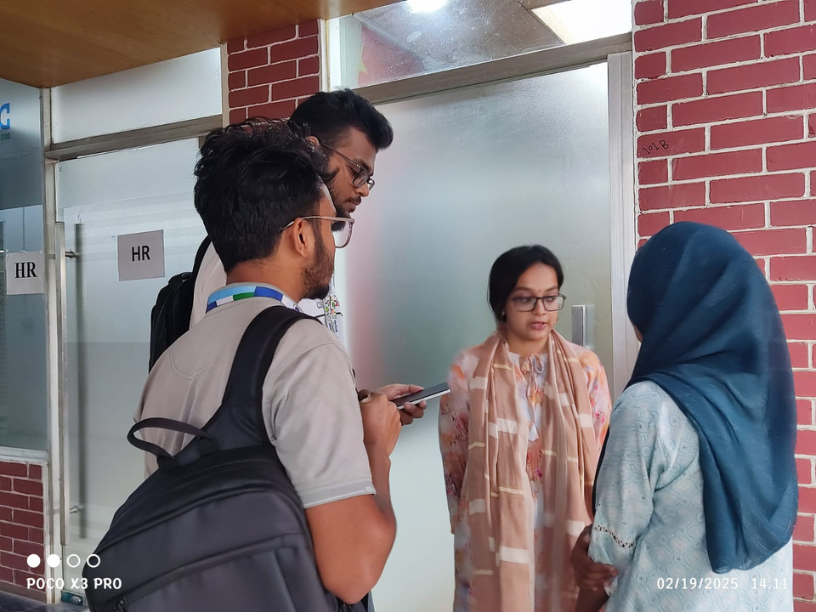
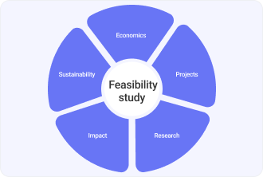


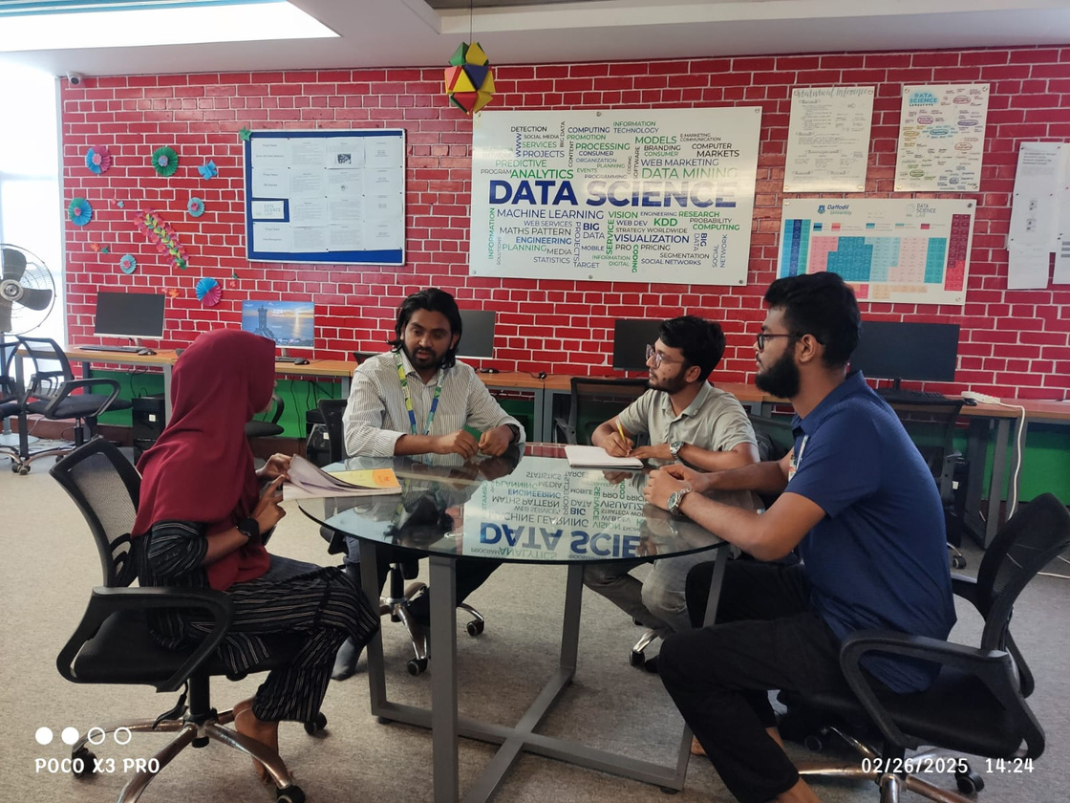
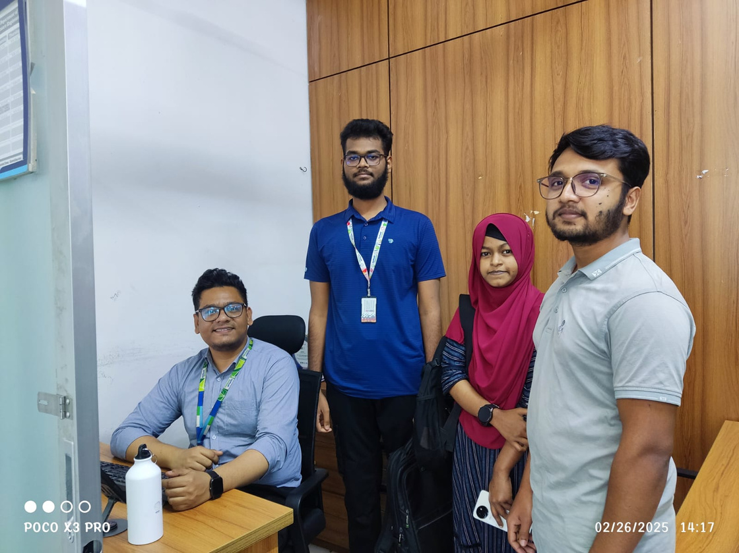


Ingoude Company
04

Slide 5
FEASIBILITY STUDY
Name | Department | Faced Issues in Club Management?
Abdul Hye Zibon | Lecturer- SWE | Yes
Md. Shohel Arman | Assistant Professor | Yes
Fazla Rabby Raihan | Lecturer- SWE | Yes
Abdur Rahman | CIS | Yes
Have Ideas for Improvement? | Experience with Current System | Response to Our Plan
Yes | Negative | Positive
No | Negative | Positive
Yes | Negative | Positive
No | -- | Positive
Rahatul Jannat | NFE | NO
Abu Taher | CSE | Yes
Antor Das | MCT | Yes
Saifullah Khan | ESDM | Yes
Yes | Negative | Negative
NO | -- | Positive
Yes | Negative | Positive
Yes | -- | Positive
05

Slide 6


WORKFLOW MANAGEMENT
Monira Islam
Research and Project Planning
Duration: 2 weeks
Reduan Ahmad
Feasibility Study
Duration: 4 days
Abdullah Al Noman
ERD Design and Database Architecture
06
Duration: 4 weeks for
first version

Slide 7


Entity For the Database
Club
Event
Member
Participation
MemberShip
Announcement
07

Slide 8

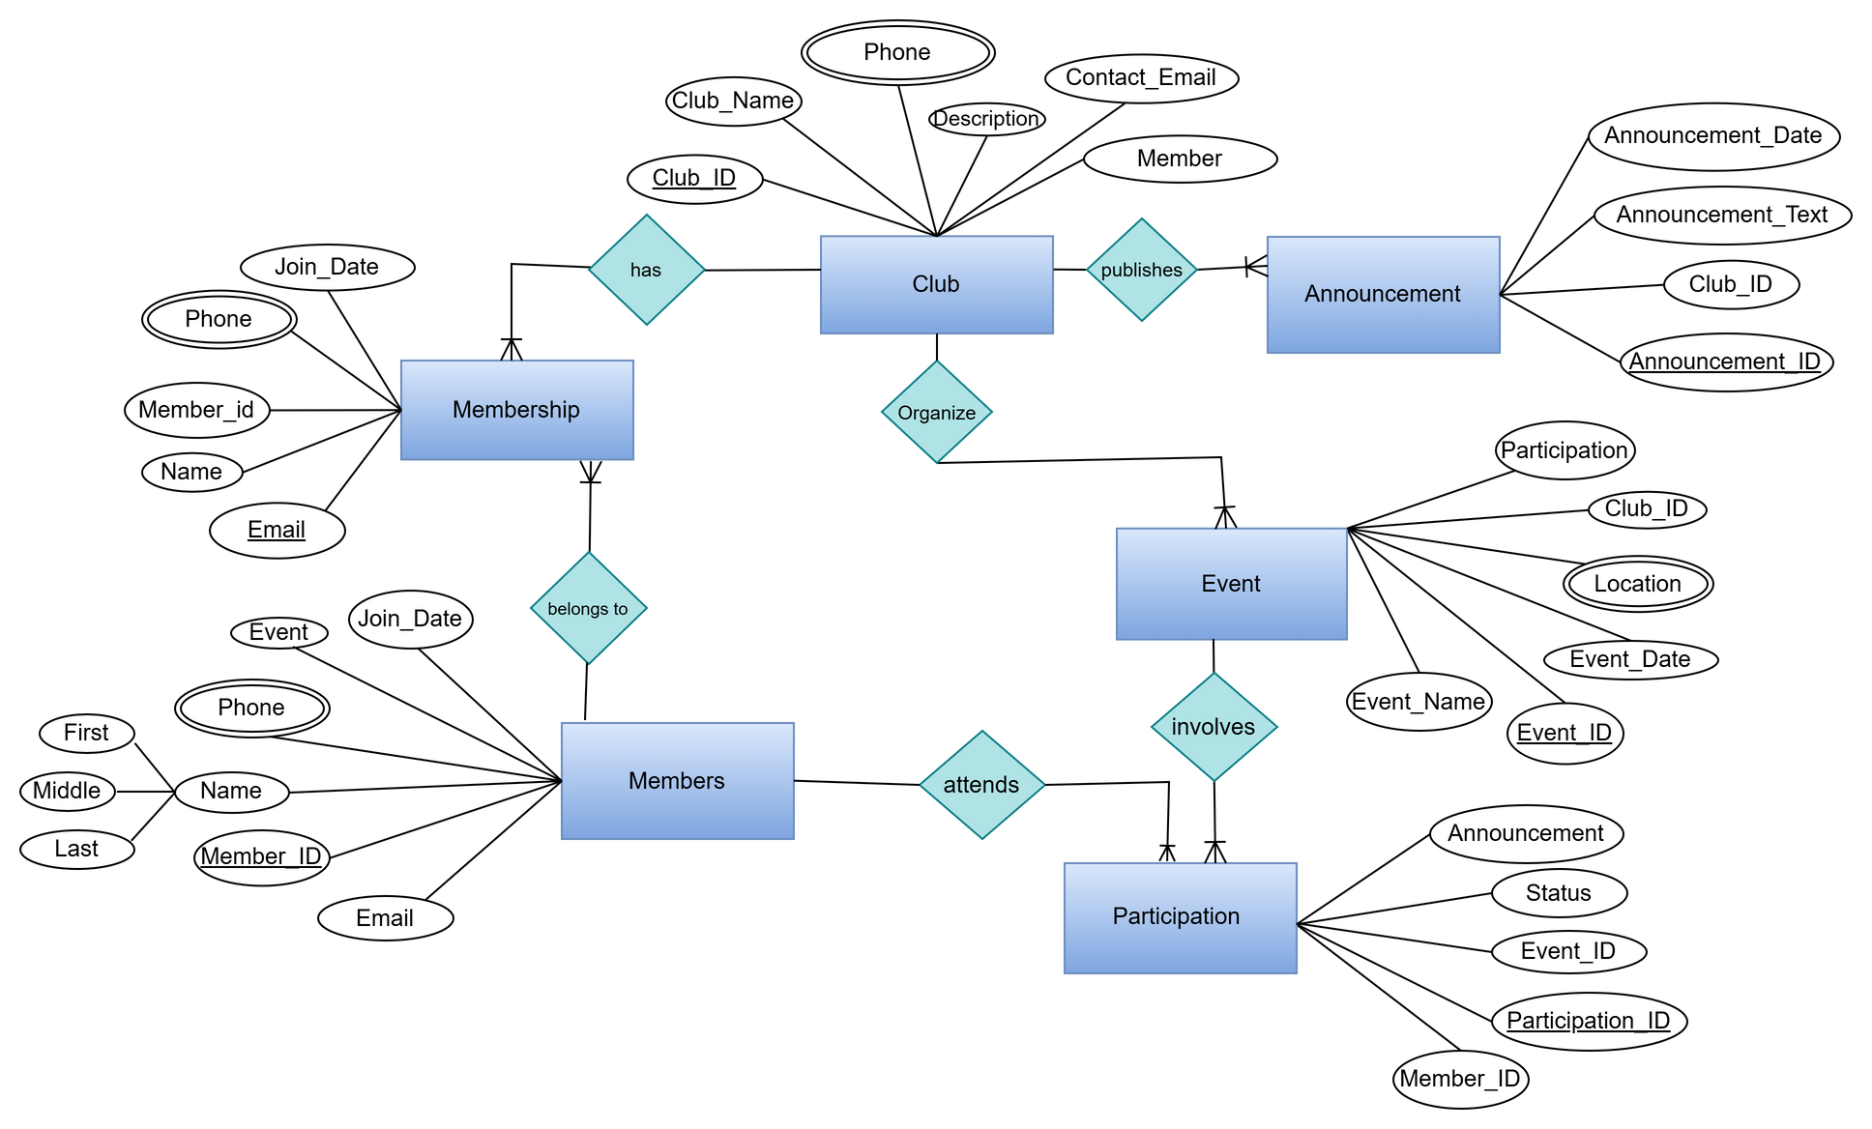

Entity Relationship Diagram
08

Slide 9

Home
Service
About Us
Contact
Thank
You
Any Questions?
09

